Slide 1

DBMS Of Automobile Showroom​
BL.EN.U4CSE20159 Sidda Siri Chandana
BL.EN.U4CSE20203 Vobbilisetti Vikas
BL.EN.U4CSE20204 Y Ghnana Prasoona
BL.EN.U4CSE20205 Yedhoti Thrinayani

Slide 2
Agenda
Abstract​
ER Diagram​
Table Conversion​
Presentation(Module Explanation)​
Demo

Slide 3




Abstract
The project is an Automobile Showroom's DBMS (for a particular branch), we have two different views or types of users in this (naive users).
Naive users: Employer and customers
Consists of Data retreival, Insertion, deletion and updation based on views.
Technologies used:

Slide 4
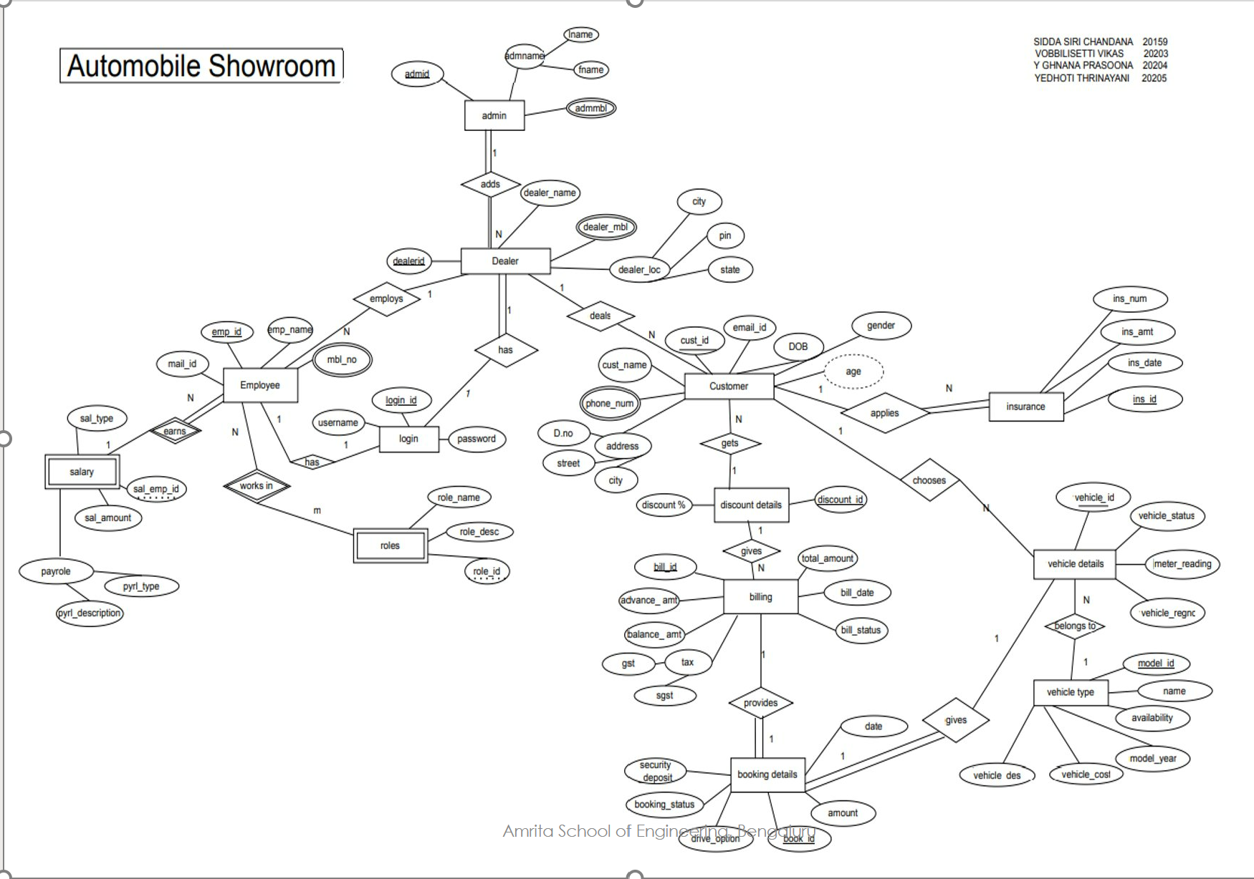
ER Diagram

Slide 5
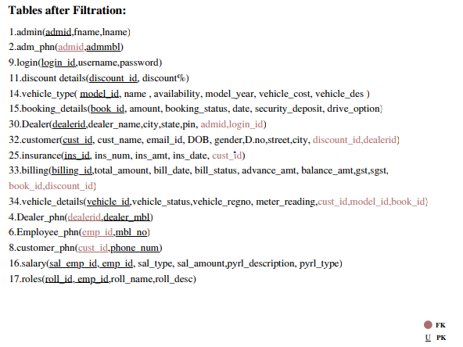

Table Conversion​

Slide 6
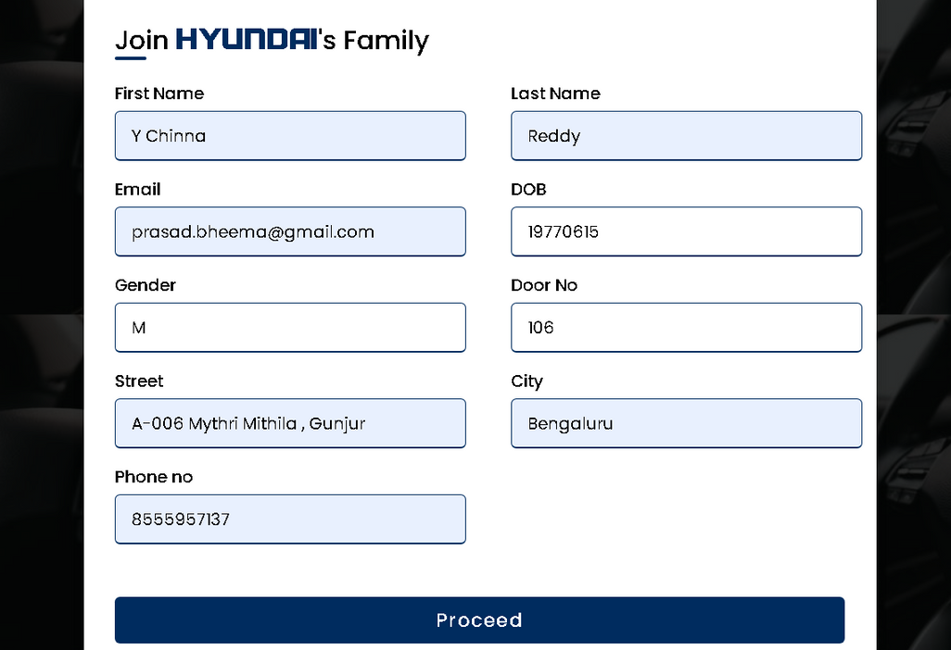
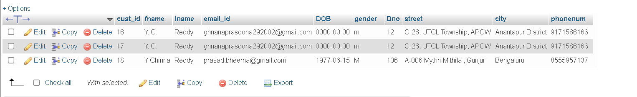
Module Explanation
Insertion module:

Slide 7

Module Explanation
Selection module:

Slide 8
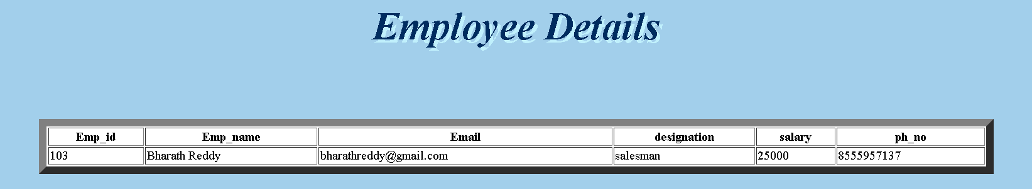
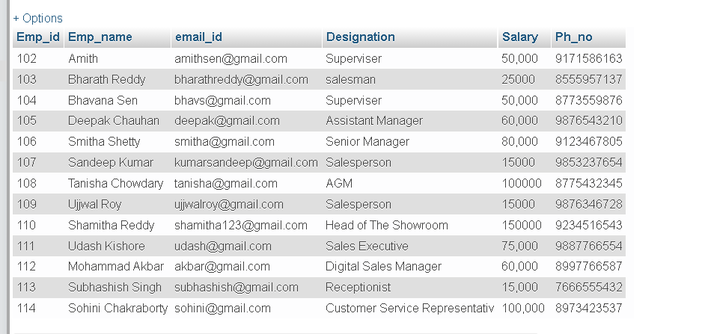
Module Explanation
Selection module:

Slide 9
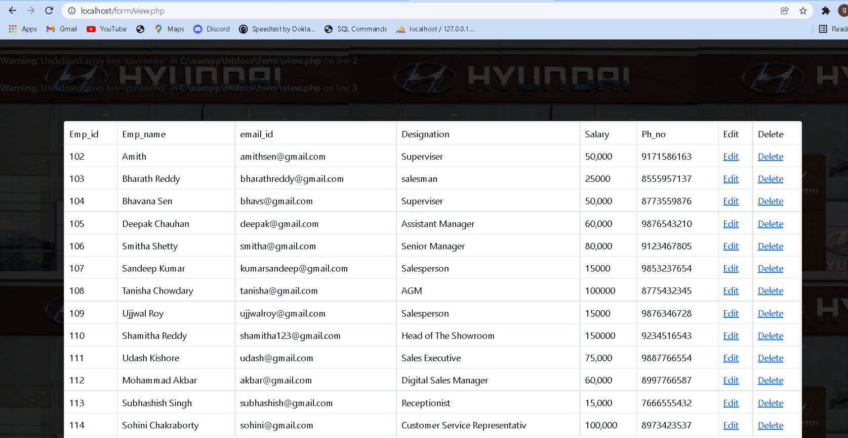
Module Explanation
Updation module:
Before Updation :

Slide 10
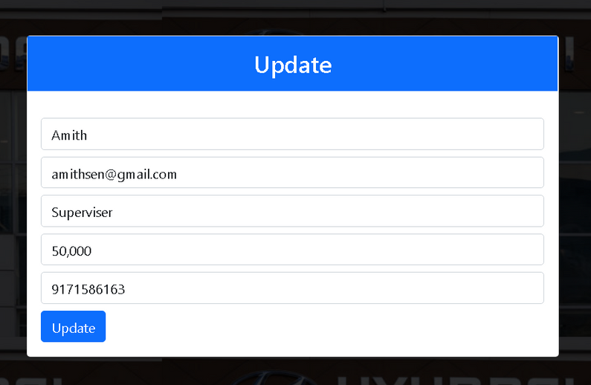
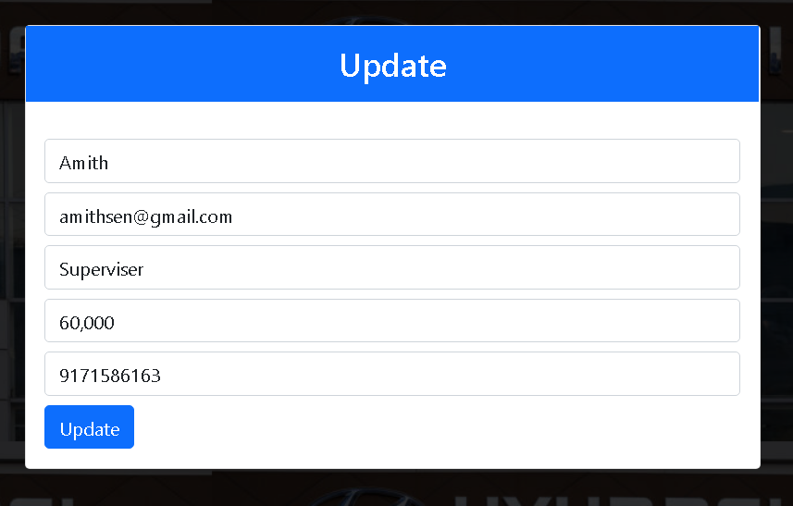
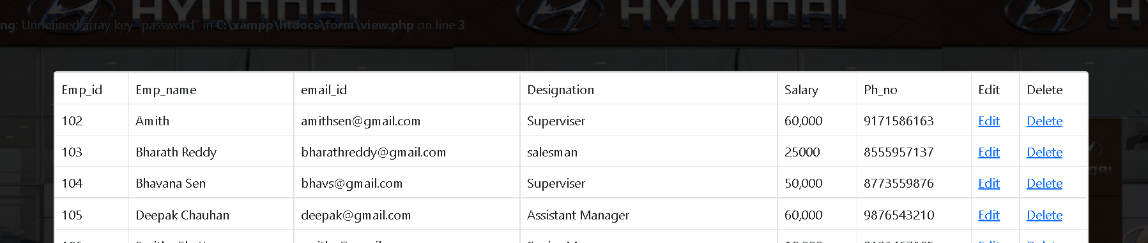
During Updation :
After Updation :

Slide 11
Module Explanation
Deletion module:
Before Deletion :

Slide 12
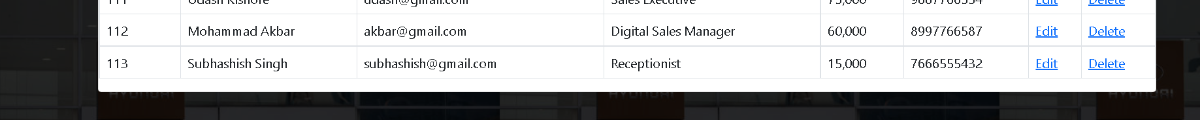
After Deletion :
WebApp Demo

